Slide 1
GTEx, PrediXcan, TWAS
HUGEN 2073
Jon Chernus
Notes:
Barbeira, A.N. et al. (2018) Exploring the phenotypic conse- quences of tissue specific gene expression variation inferred from GWAS summary statistics. Nat. Commun. 9, 1825
Gusev, A. et al. (2016) Integrative approaches for large-scale transcriptome-wide association studies. Nat. Genet. 48, 245–252
Gamazon, E.R. et al. (2015) A gene-based association method for mapping traits using reference transcriptome data. Nat.
Genet. 47, 1091–1098
Zhu, Z. et al. (2016) Integration of summary data from GWAS
and eQTL studies predicts complex trait gene targets. Nat.
Genet. 48, 481–487
Hormozdiari, F. et al. Colocalization of GWAS and eQTL signals detects target genes. Am. J. Hum. Genet. 99, 1245–1260 (2016).Return to ref 19 in article
CAS Article PubMed PubMed Central Google Scholar
Wen, X., Pique-Regi, R. & Luca, F. Integrating molecular QTL data into genome-wide genetic association analysis: Probabilistic assessment of enrichment and colocalization. PLOS Genet. 13, e1006646 (2017).Return to ref 20 in article
Article PubMed PubMed Central Google Scholar

Slide 2
Motivation
So far, we’ve mainly discussed “variant-levels” methods/tools
Annotating (GWAS) variants
Finding evidence a (GWAS) variant may be involved in a trait (primarily by “mapping” it to a gene)

Slide 3
Motivation
We’ve also discussed some gene-based methods/tools
Gene-based association tests (e.g., MAGMA)
Finding evidence a pathway/functional category may be involved in a trait (pathway/gene set analysis)

Slide 4
Motivation
Often we think of genes as the “bricks” of the “genetic architecture.”
We ask, “Does this particular (GWAS) variant somehow affect a gene’s function in a way that’s relevant to a particular trait?”
If gene function takes us a step closer to the biology of a trait…
Can we quantify/define “gene function” in a simple/systematic way?
Can we actually measure this for individuals somehow?
Can we then test each gene’s “gene function” for association with a trait?

Slide 5
Review of eQTLs
What is an eQTL?

Slide 6
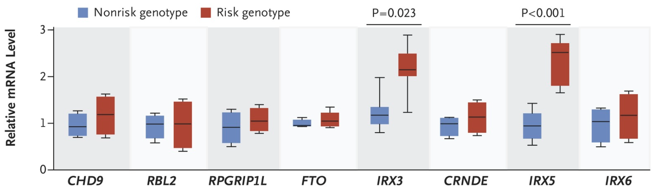
Expression quantitative trait locus
An eQTL is a locus at which genotype affects transcription of a gene.
Notes:
Image sources:
https://www.nejm.org/doi/full/10.1056/nejmoa1502214
https://www.nature.com/articles/ng.3538

Slide 7
Why do we care about eQTLs?
???

Slide 8
Why we care about eQTLs
eQTLs are enriched in GWAS signals.
See, e.g. Nicolae, D. L., Gamazon, E., Zhang, W., Duan, S., Dolan, M. E., & Cox, N. J. (2010). Trait-associated SNPs are more likely to be eQTLs: annotation to enhance discovery from GWAS. PLoS genetics, 6(4), e1000888. https://doi.org/10.1371/journal.pgen.1000888 https://pubmed.ncbi.nlm.nih.gov/20369019/ And, if we think a gene matters for a trait, we might be interested in the effect of its expression level. For a discussion, see Umans, B. D., Battle, A., & Gilad, Y. (2021). Where Are the Disease-Associated eQTLs?. Trends in genetics : TIG, 37(2), 109–124. https://doi.org/10.1016/j.tig.2020.08.009 https://www.cell.com/trends/genetics/fulltext/S0168-9525(20)30209-2

Slide 9
What are some complicating factors about eQTLs?

Slide 10
eQTL complications
Context is important
variant, gene, and tissue
Has anyone even studied the “right” kind of cell for your trait?
Other factors may matter, too
Environment (have relevant conditions been studied?)
Stimuli (ditto)
Population?
Other considerations
Post-mortem samples
Cis- vs. trans-eQTLs
Splicing eQTLs
Transcription =/= translation
Correlation =/= causation
Rare variants may be poorly represented in databases

Slide 11
Where can we find transcriptome data?
Some examples of databases with gene expression:
GTEx
GEUVADIS (Genetic European Variation in Health and Disease)
GEO (Gene Expression Omnibus)
eQTLGen
ArrayExpress
TCGA
Expression Atlas
dbGaP
Human Cell Atlas (HCA)
Single Cell Portal (Broad Institute)
Many others…

Slide 12
GTEx
https://www.gtexportal.org/home/
https://www.gtexportal.org/home/documentationPage (summary of methods)
GTEx (Genotype-Tissue Expression project) is a database of eQTLs.
Notes:
Here’s a list of some expression databases. Not sure if these contain eQTL info, too. Not sure why this doesn’t list GTEx.
https://www.hsls.pitt.edu/obrc/index.php?page=gene_expression_databases

Slide 13
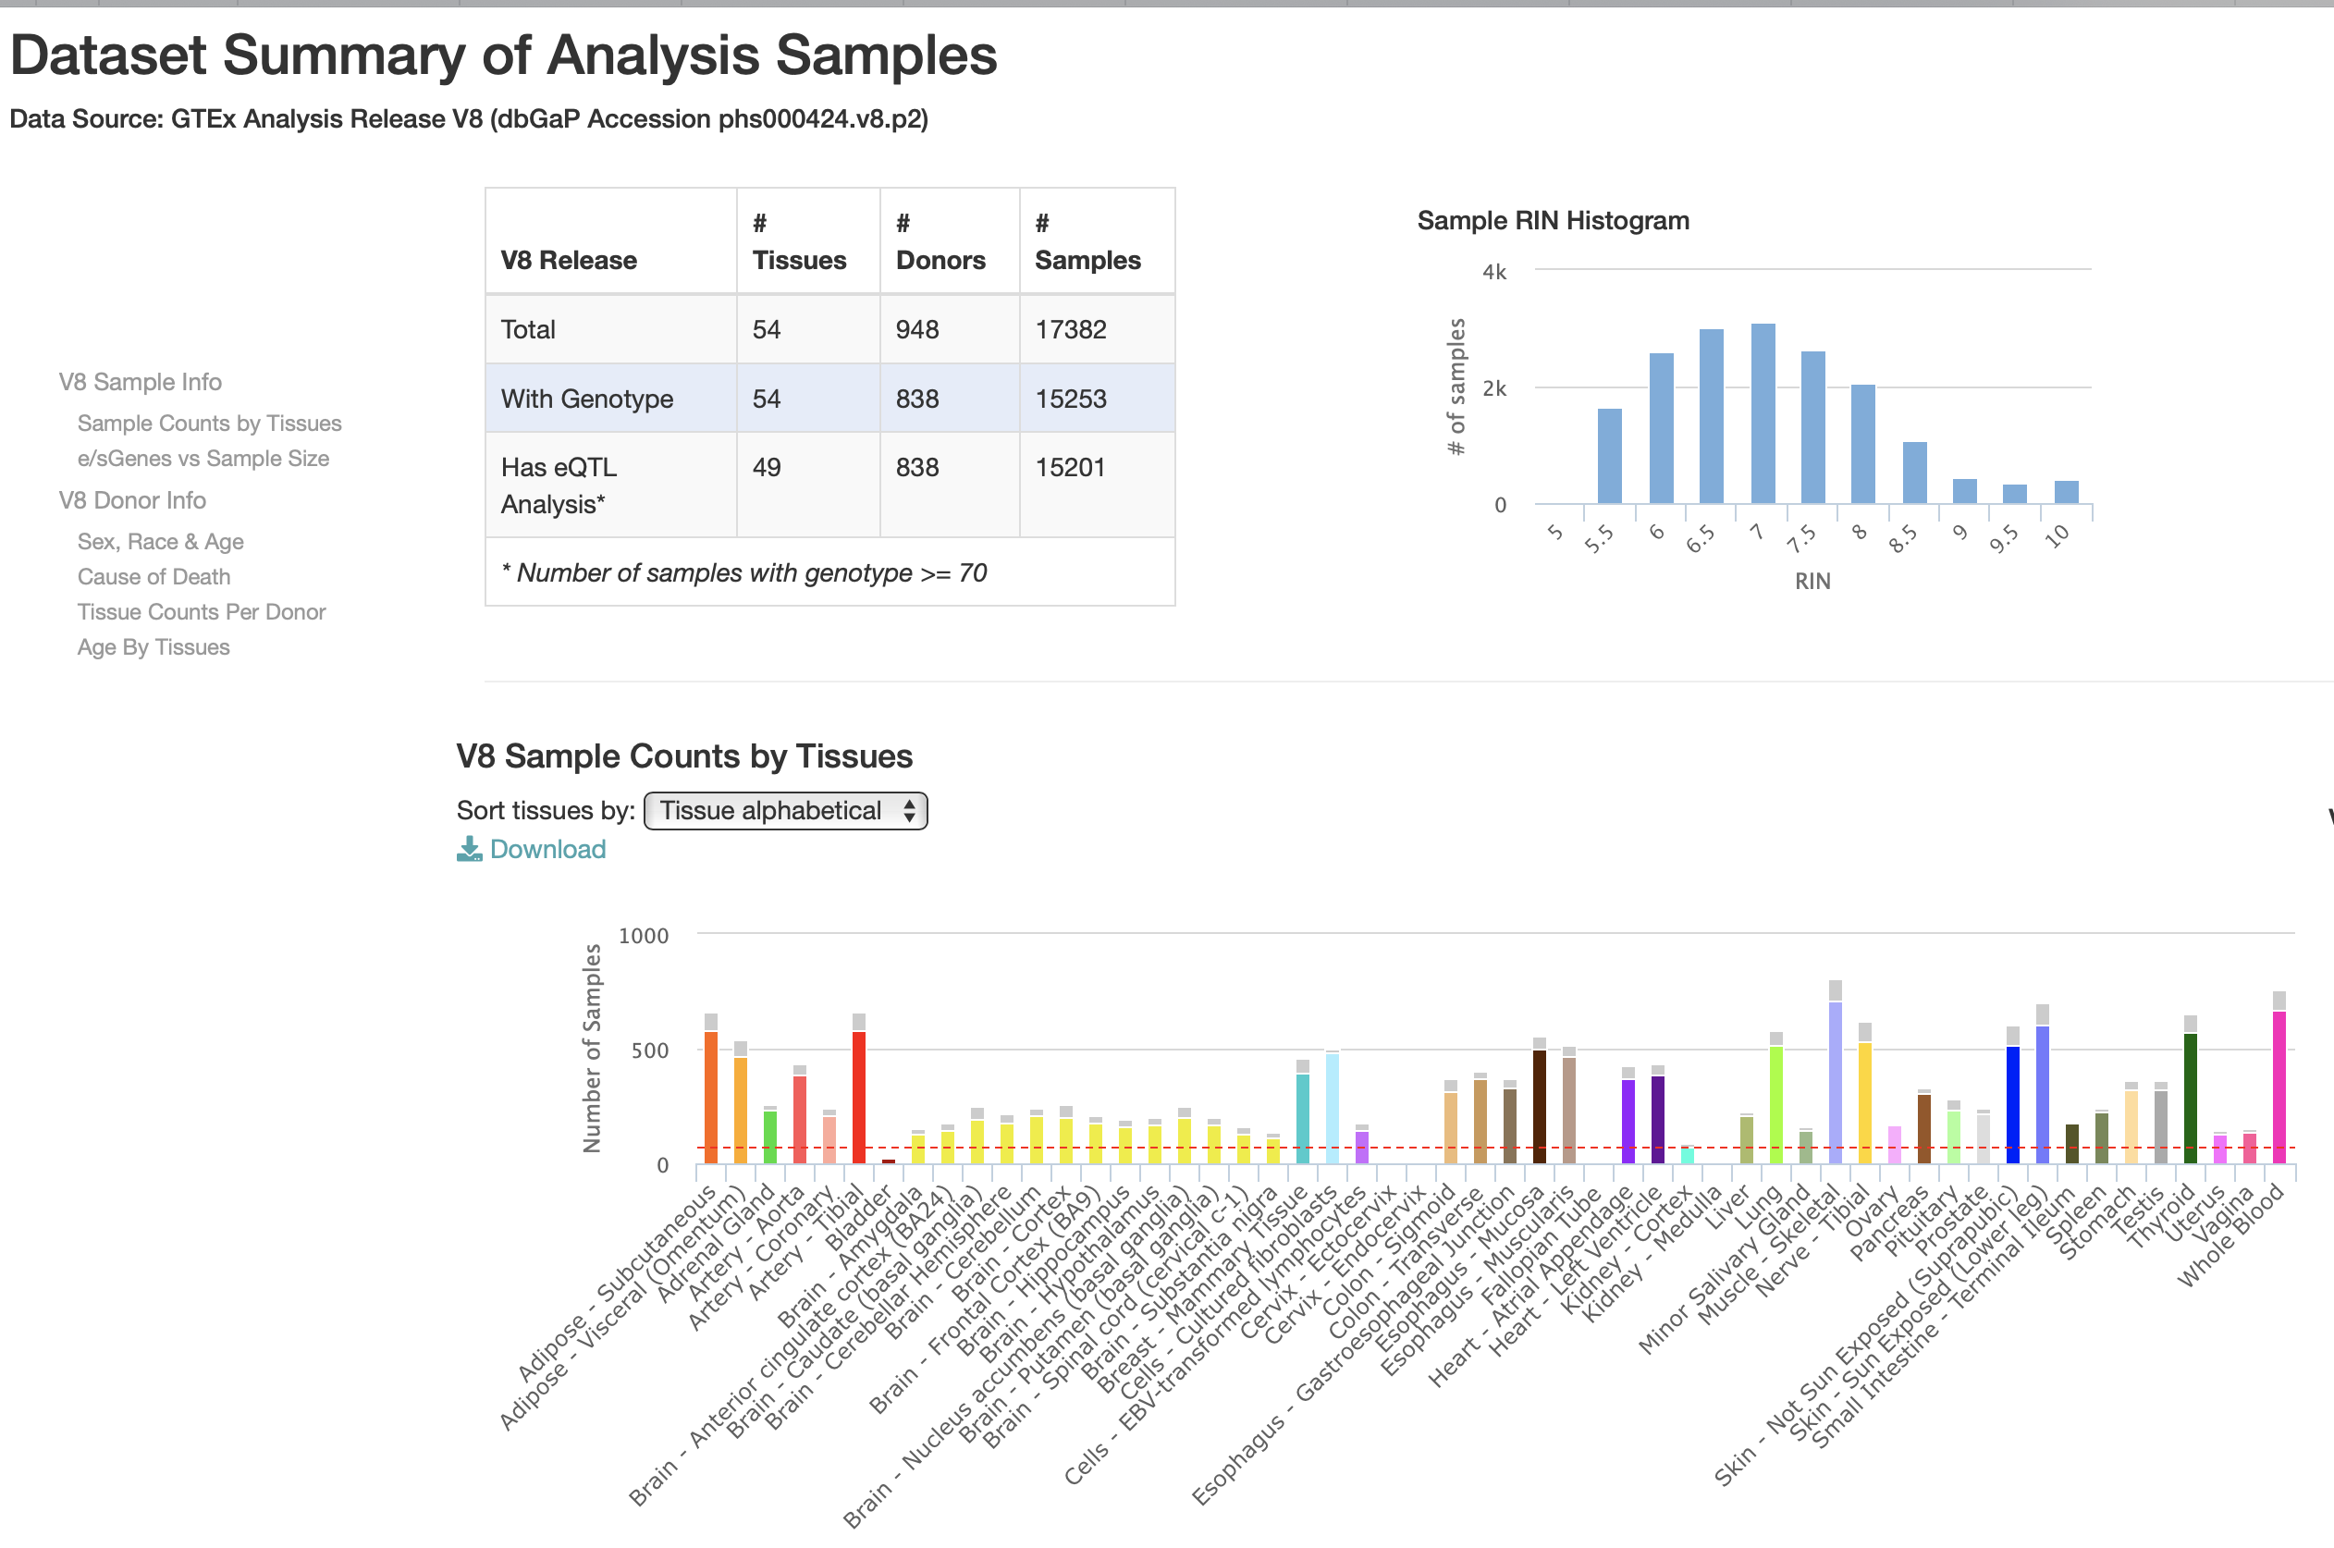
GTEx

Slide 14
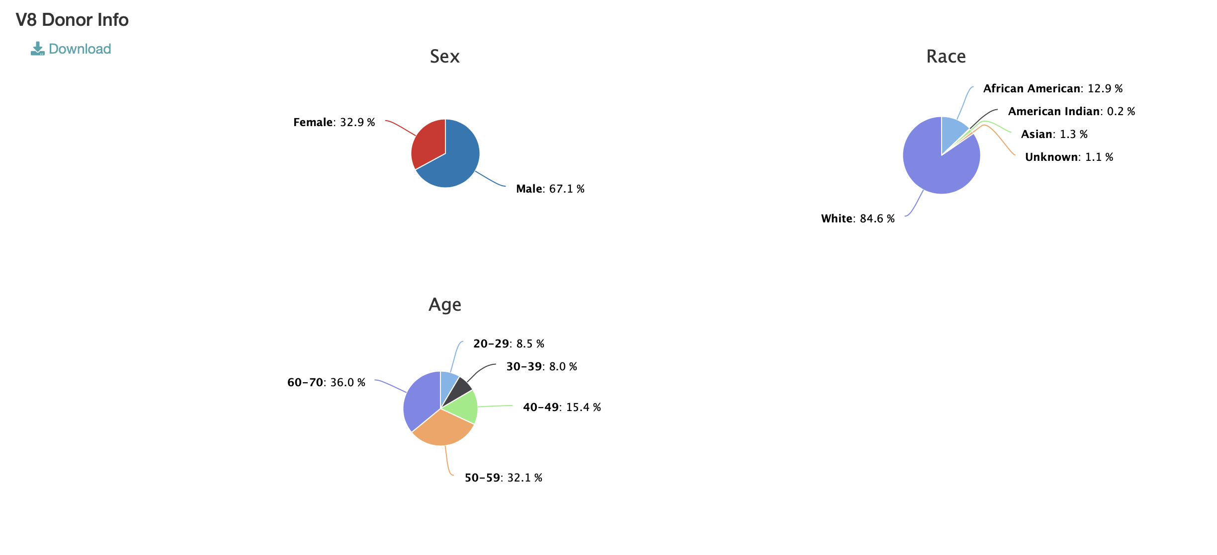
GTEx

Slide 15
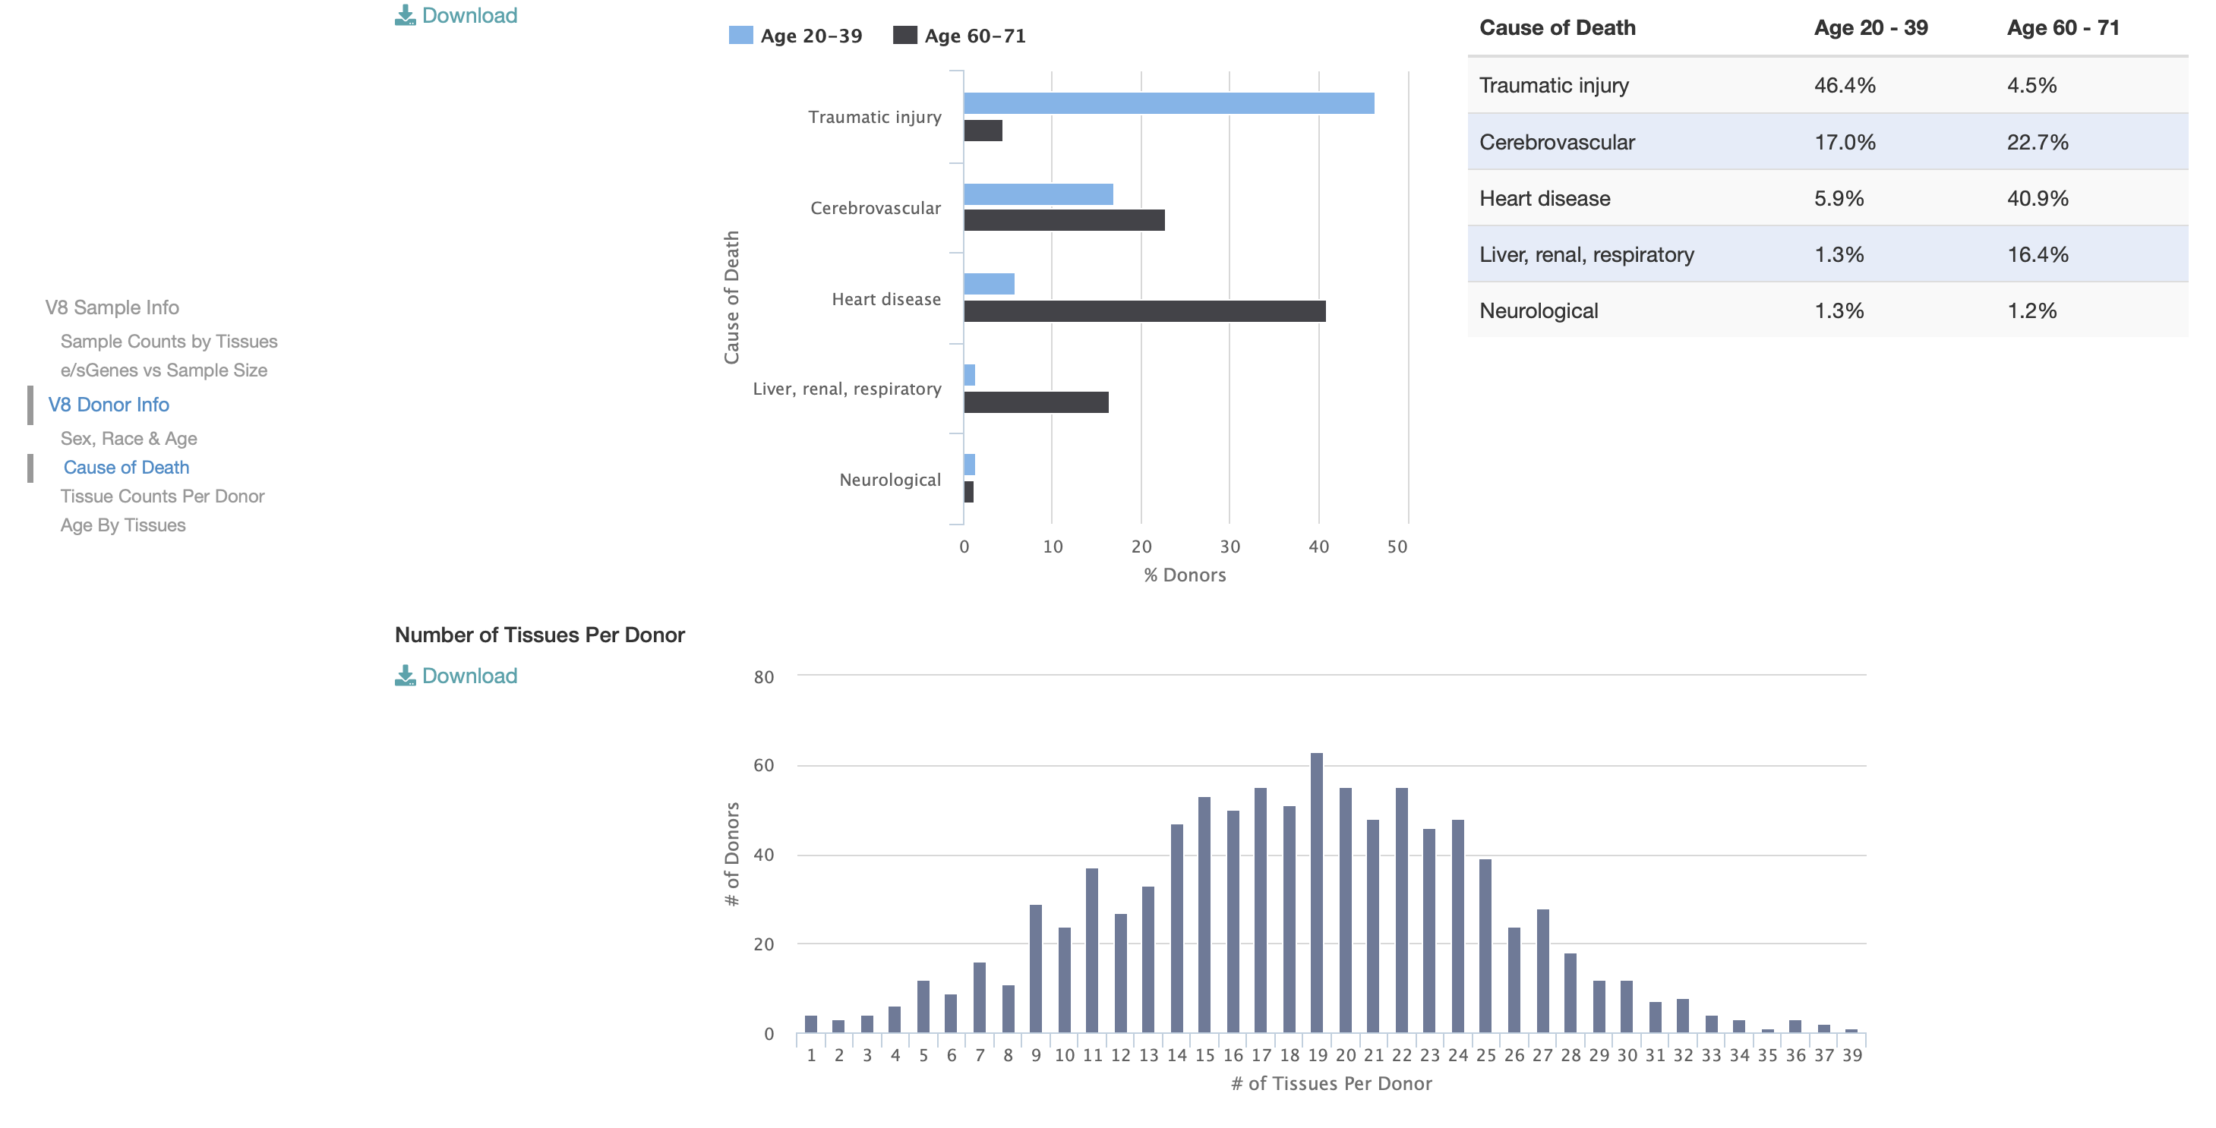
GTEx

Slide 16
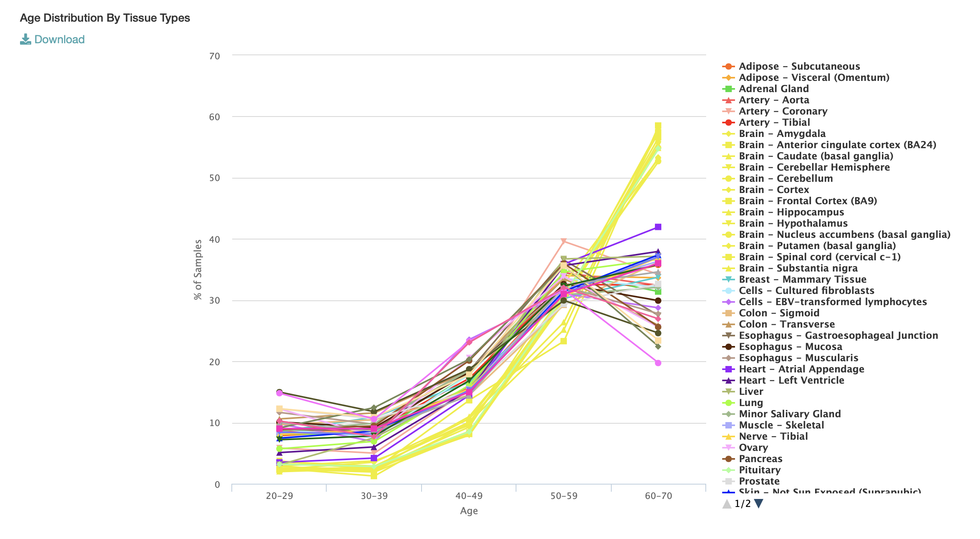
GTEx

Slide 17
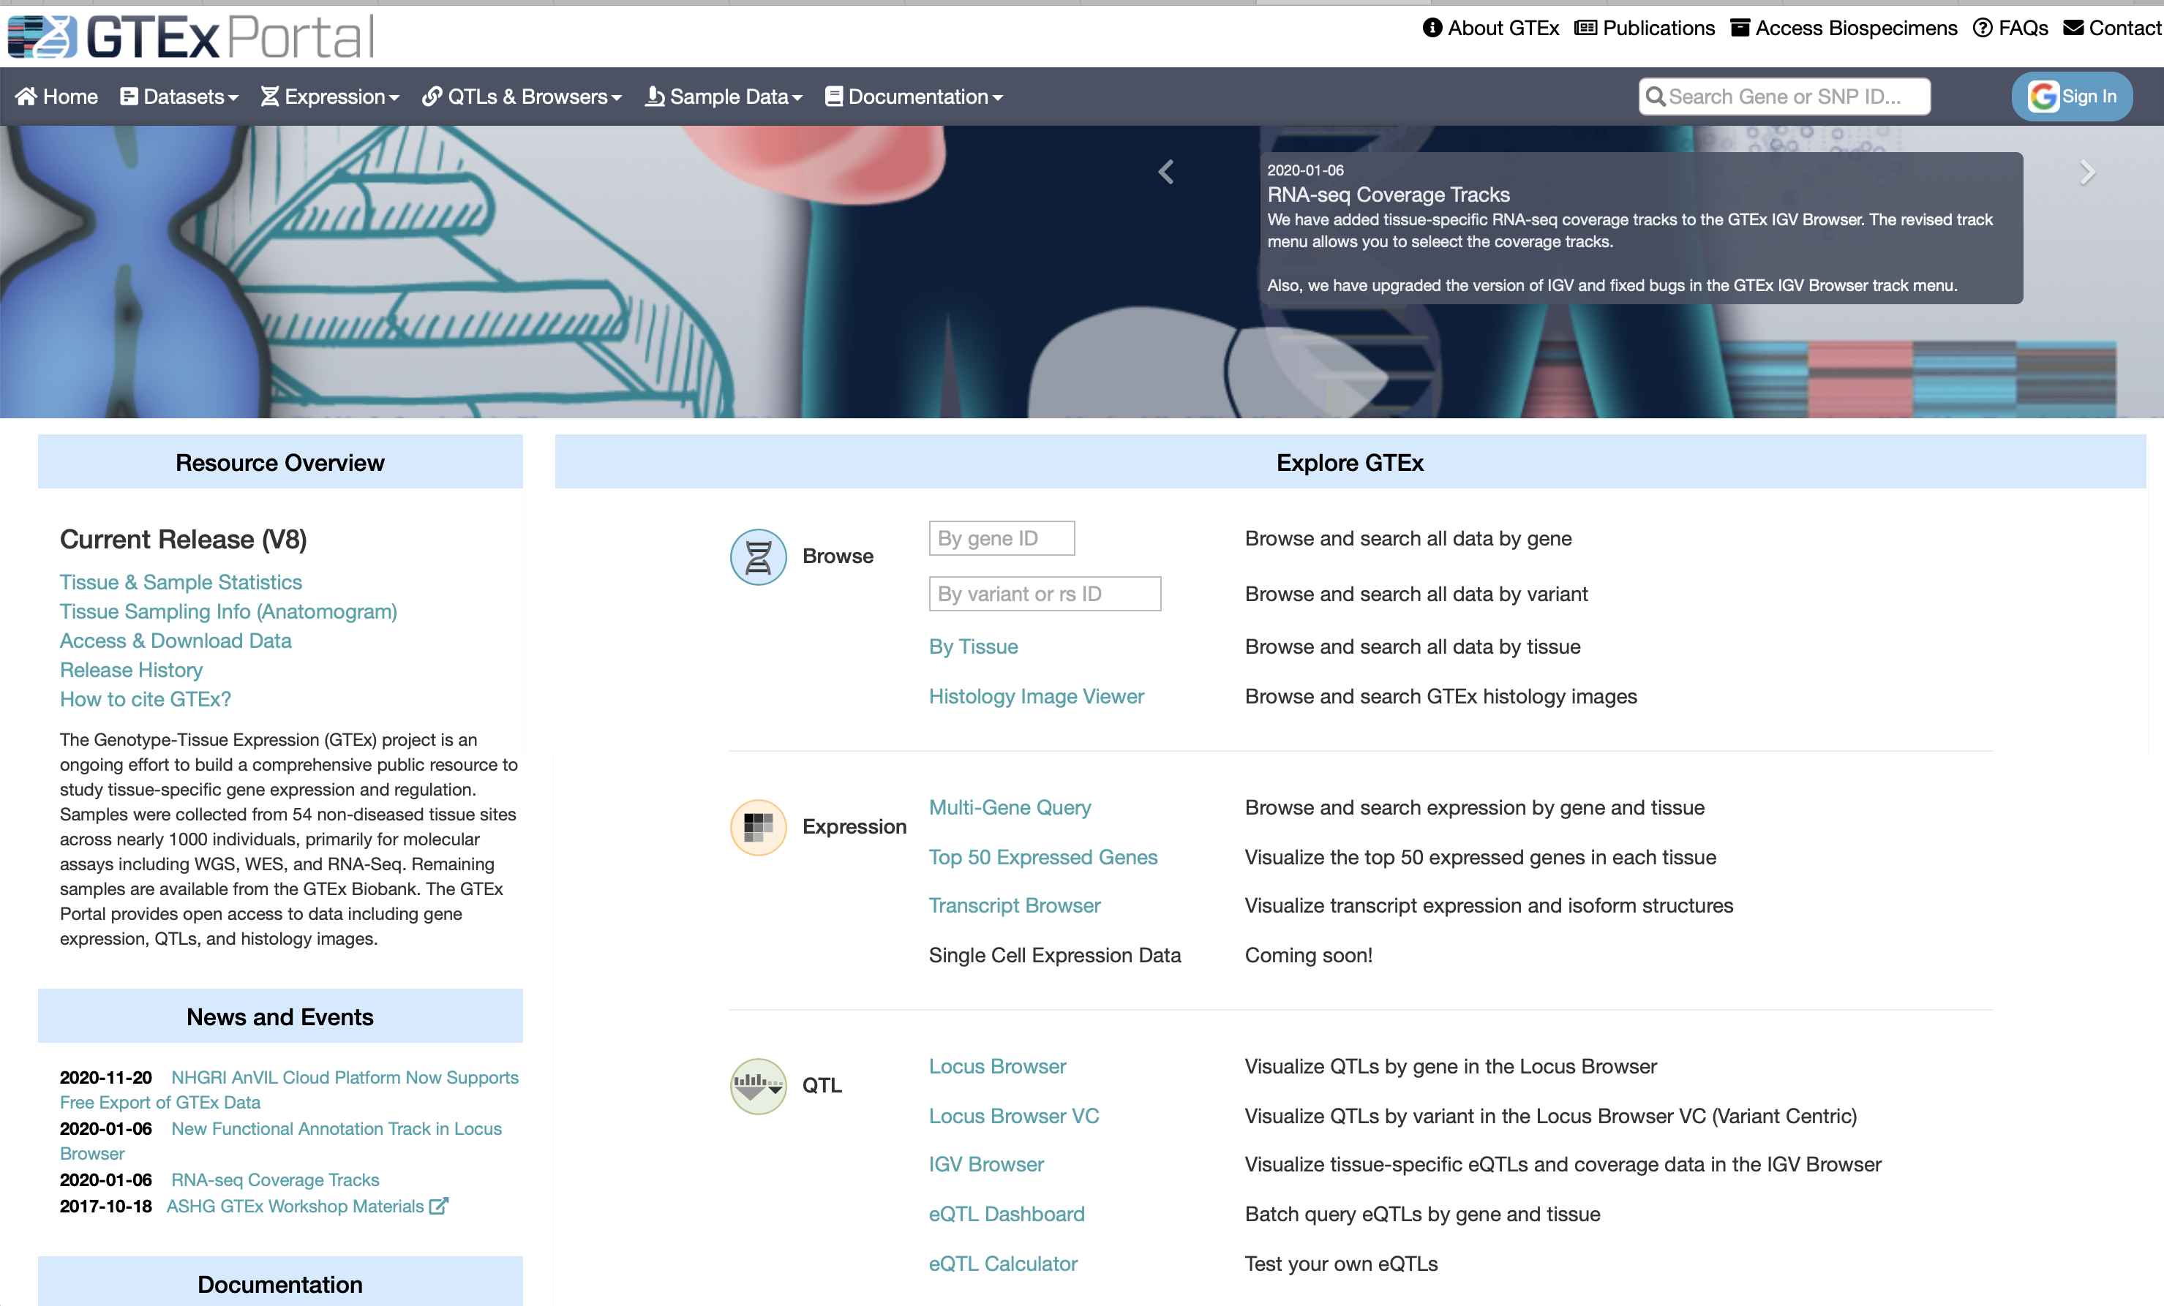
GTEx

Slide 18
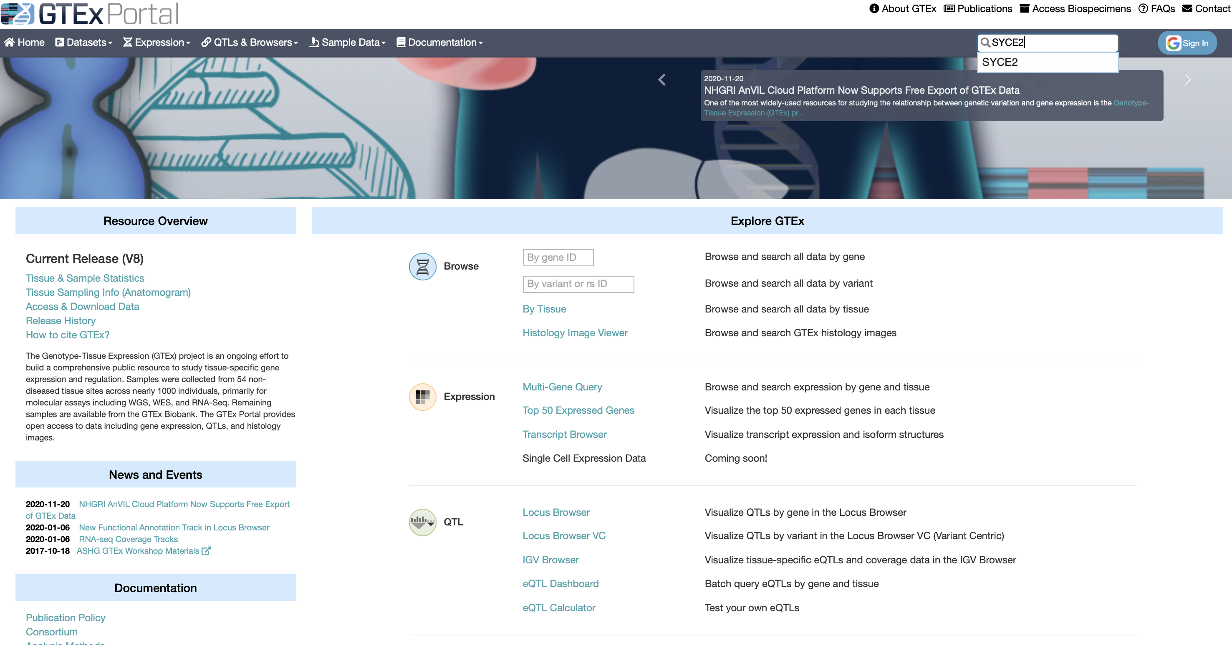
GTEx Portal Examples
Search a gene, e.g., SYCE2

Slide 19
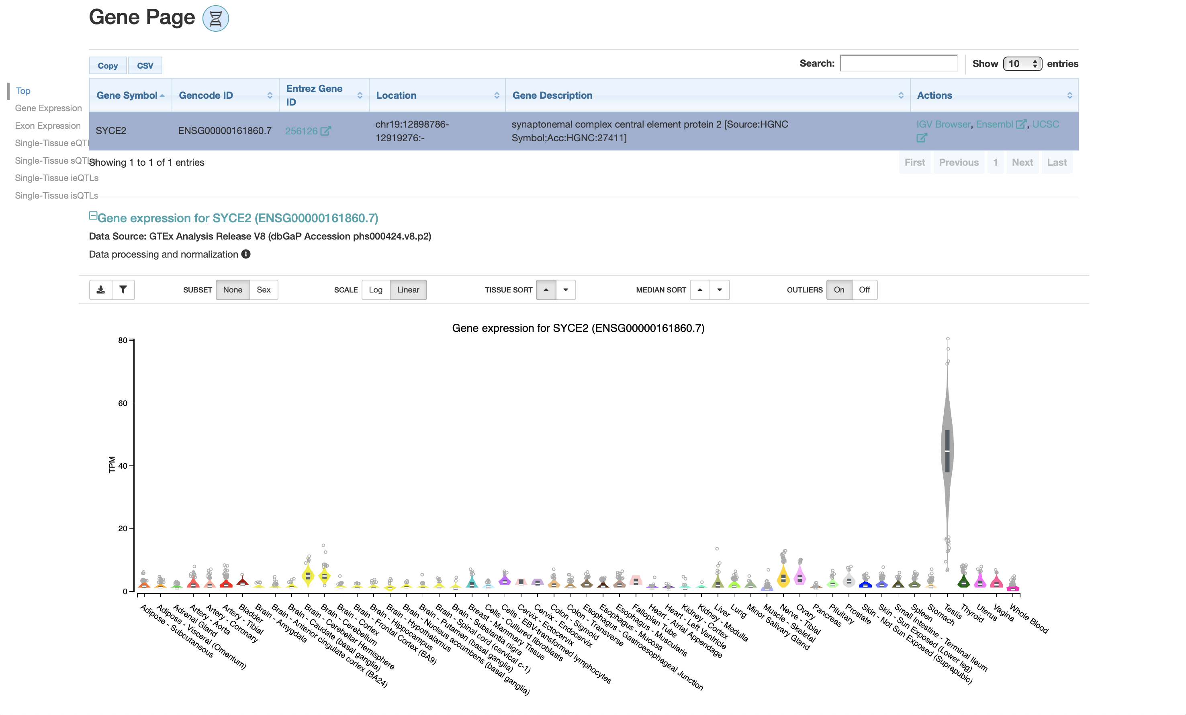
GTEx Portal Examples
Notes:
https://www.gtexportal.org/home/gene/SYCE2

Slide 20
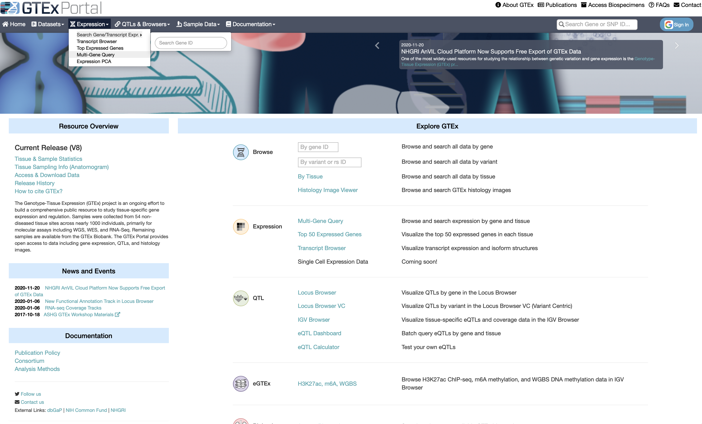
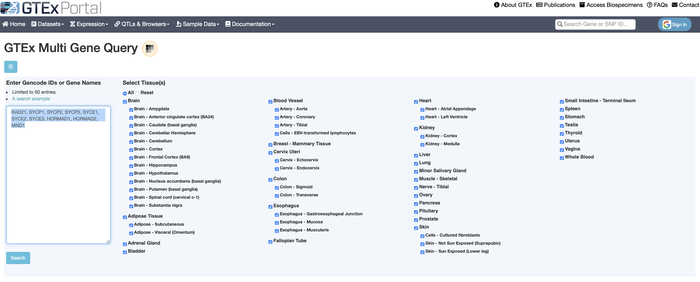
GTEx Portal Examples
Search multiple genes
Notes:
RAD21, SYCP1, SYCP2, SYCP3, SYCE1, SYCE2, SYCE3, HORMAD1, HORMAD2, MND1

Slide 21
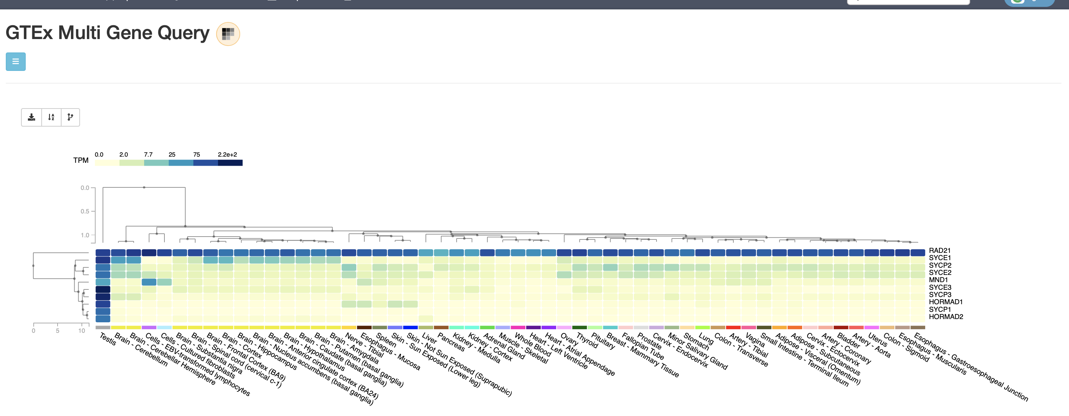
GTEx Portal Examples

Slide 22
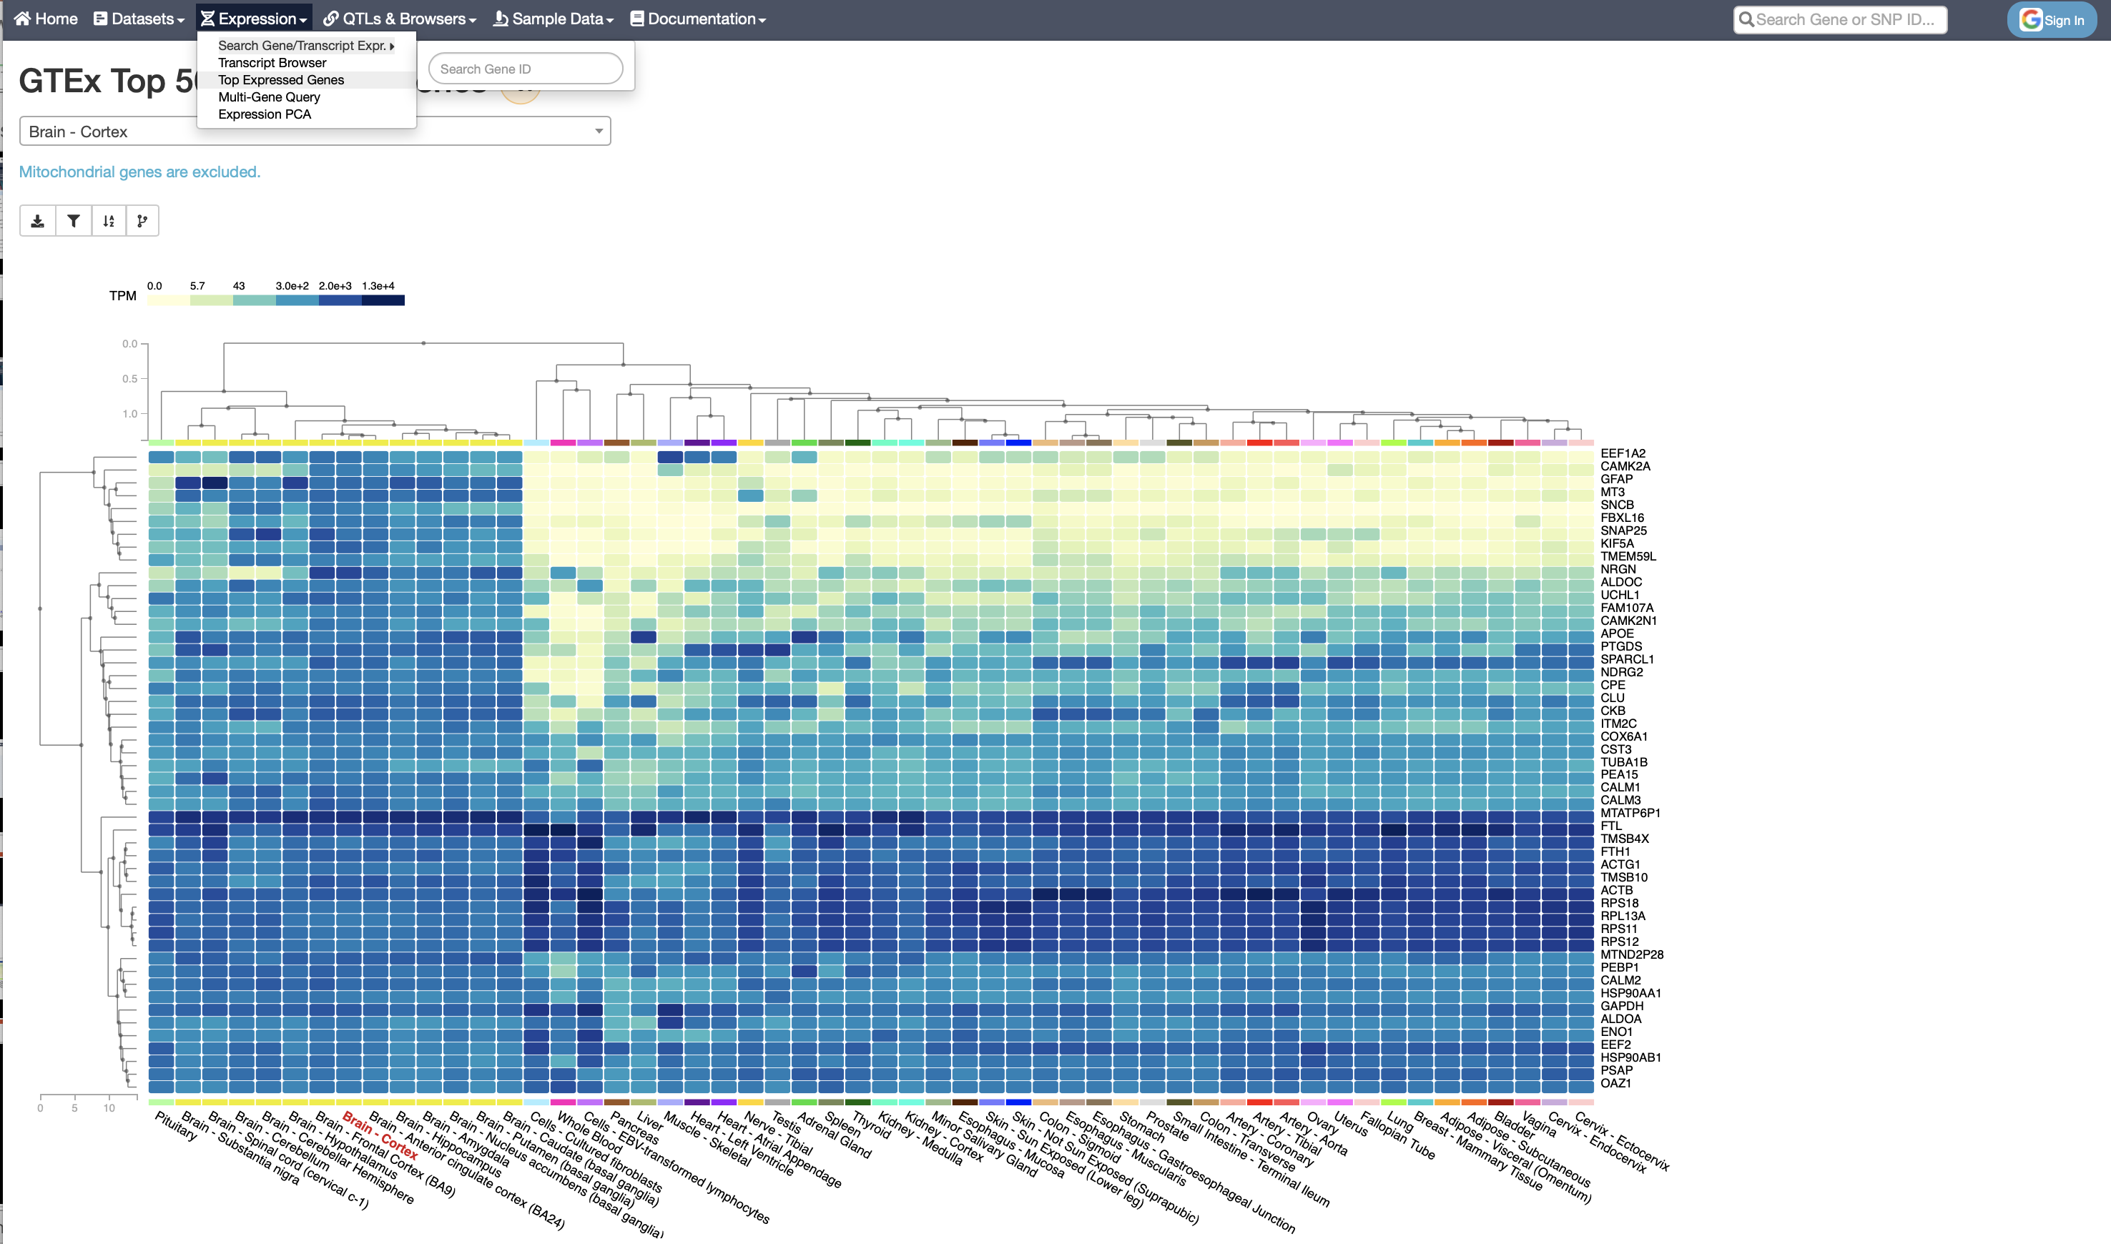
GTEx Portal Examples
Search top expressed genes by tissue

Slide 23
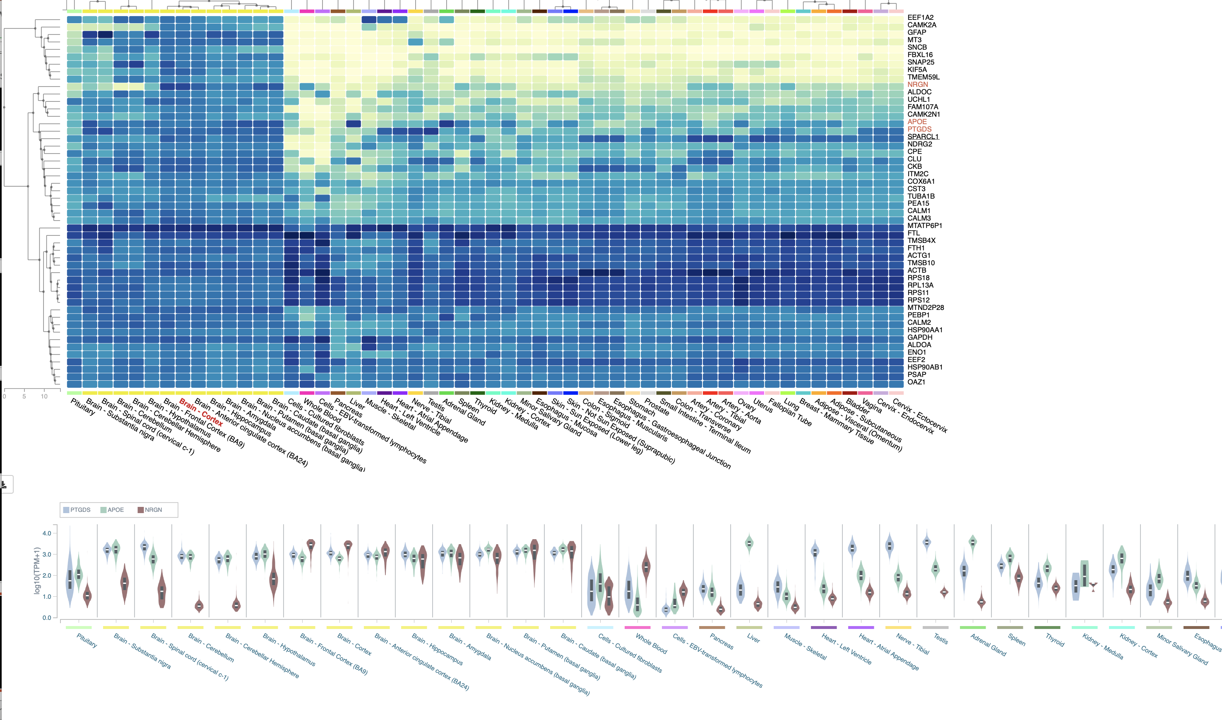
GTEx Portal Examples
Select genes to show violin plots

Slide 24
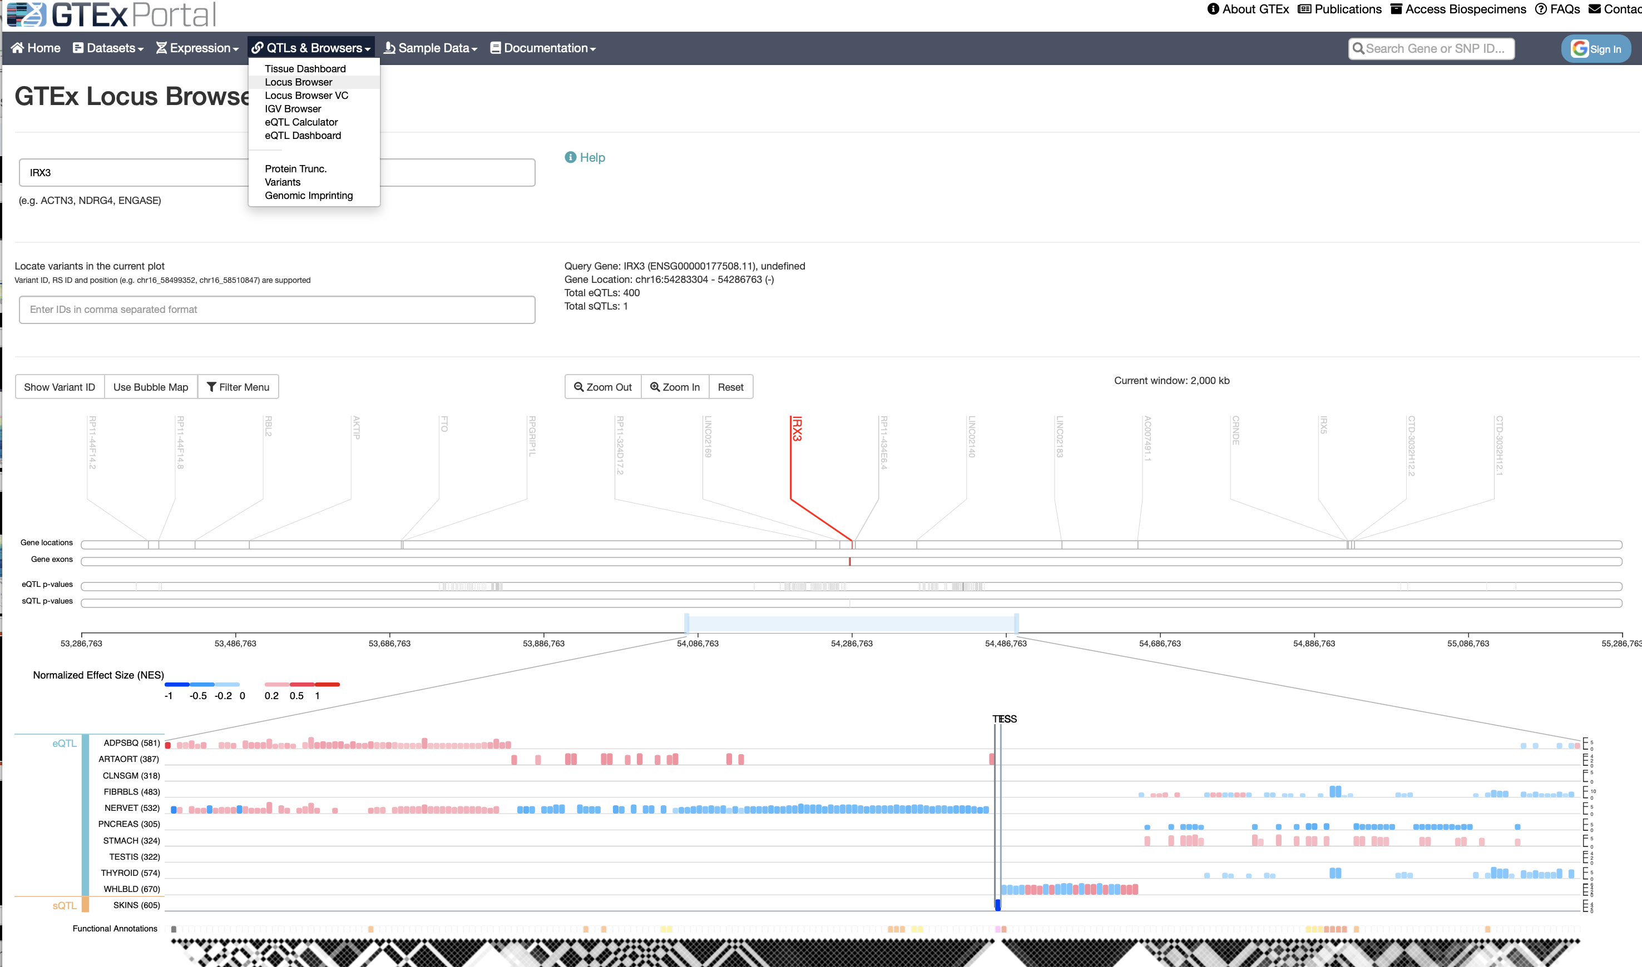
GTEx Portal Examples
Search a gene for its eQTLs

Slide 25
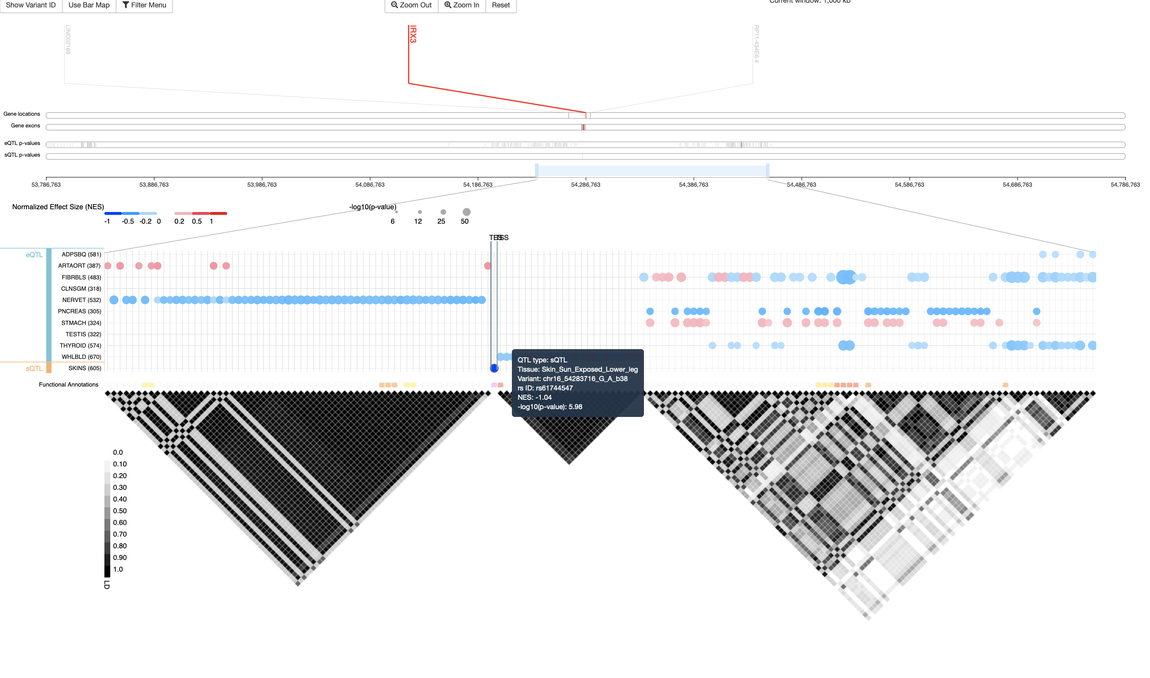
GTEx Portal Examples
Notes:
Or try this: https://www.gtexportal.org/home/geneEqtlVisualizerPage/IRX3

Slide 26
Genotype + transcriptome integration
Earlier we talked about reasons for testing genes instead of only SNPs.
We asked:
Can we quantify/define “gene function” in a simple/systematic way?
Can we actually measure this for individuals somehow?
Can we then test each gene’s “gene function” for association with a trait?

Slide 27
Genotype + transcriptome integration
Earlier we talked about reasons and methods for testing genes instead of only SNPs.
Can we quantify/define “gene function” in a simple/systematic way?
Yes, by considering expression as an intermediate variable between genotype and phenotype
Can we actually measure this for individuals somehow?
Yes, by using eQTL databases to impute individuals’ expression (for each gene/tissue) from their genotypes
Can we then test each gene’s “gene function” for association with a trait?
Yes, by performing transcriptome-wide association study (TWAS)

Slide 28
TWAS
Input data
GWAS dataset
Genotypes
Phenotypes
Transcriptome database
eQTL associations as a “training set” for predicting/imputing transcription in your GWAS data

Slide 29
TWAS
There are different methods for implementing the TWAS idea. Here we’ll focus on PrediXcan.
See:
Gamazon, E. R., Wheeler, H. E., Shah, K. P., Mozaffari, S. V., Aquino-Michaels, K., Carroll, R. J., Eyler, A. E., Denny, J. C., GTEx Consortium, Nicolae, D. L., Cox, N. J., & Im, H. K. (2015). A gene-based association method for mapping traits using reference transcriptome data. Nature genetics, 47(9), 1091–1098. https://doi.org/10.1038/ng.3367
(https://www.ncbi.nlm.nih.gov/pmc/articles/PMC4552594/)

Slide 30
PrediXcan conceptual model
Mechanism tested by the PrediXcan method This figure shows the conceptual decomposition of the expression level of a gene into three components: genetically determined component, a component altered by the trait itself, and the remaining factors (including environment). PrediXcan estimates the genetically regulated component of expression (GReX) and correlates it with the trait to identify trait-associated genes.
Notes:
Make it clear that the entire circle represents ”all” determinants of gene expression.

Slide 31
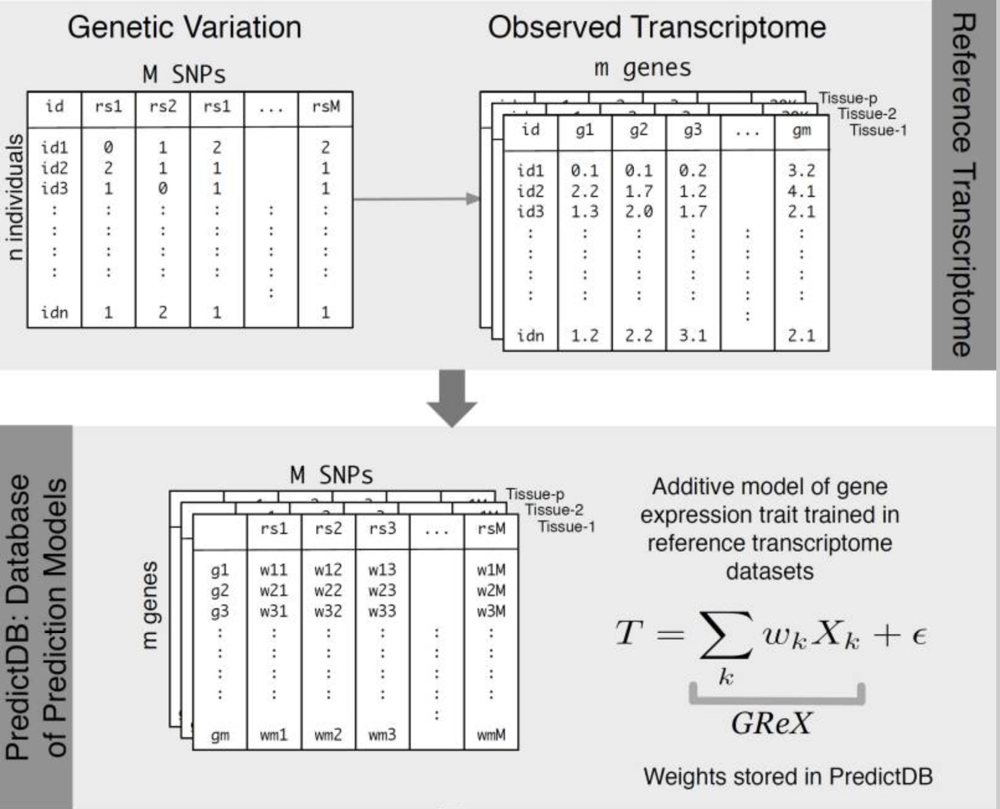
PrediXcan – training data
Top panel: Reference data (a transcriptome database like GTEx).
Known genotypes + known transcription levels in several tissues.
Bottom panel: Train a model for using genotype to predict expression of each gene in each tissue.
Model essentially involves choosing which variants (eQTLs) to use as predictors and what “weight” (effect) to assign for each variant’s genotype. Weights are “learned” using statistical learning algorithms such as LASSO or elastic net.
T = transcription level of a given gene
X_{k} = number of ref. alleles (0, 1, or 2) for the k^{th} SNP being used to predict T for the gene
w_{k} = effect for k^{th} SNP

Slide 32
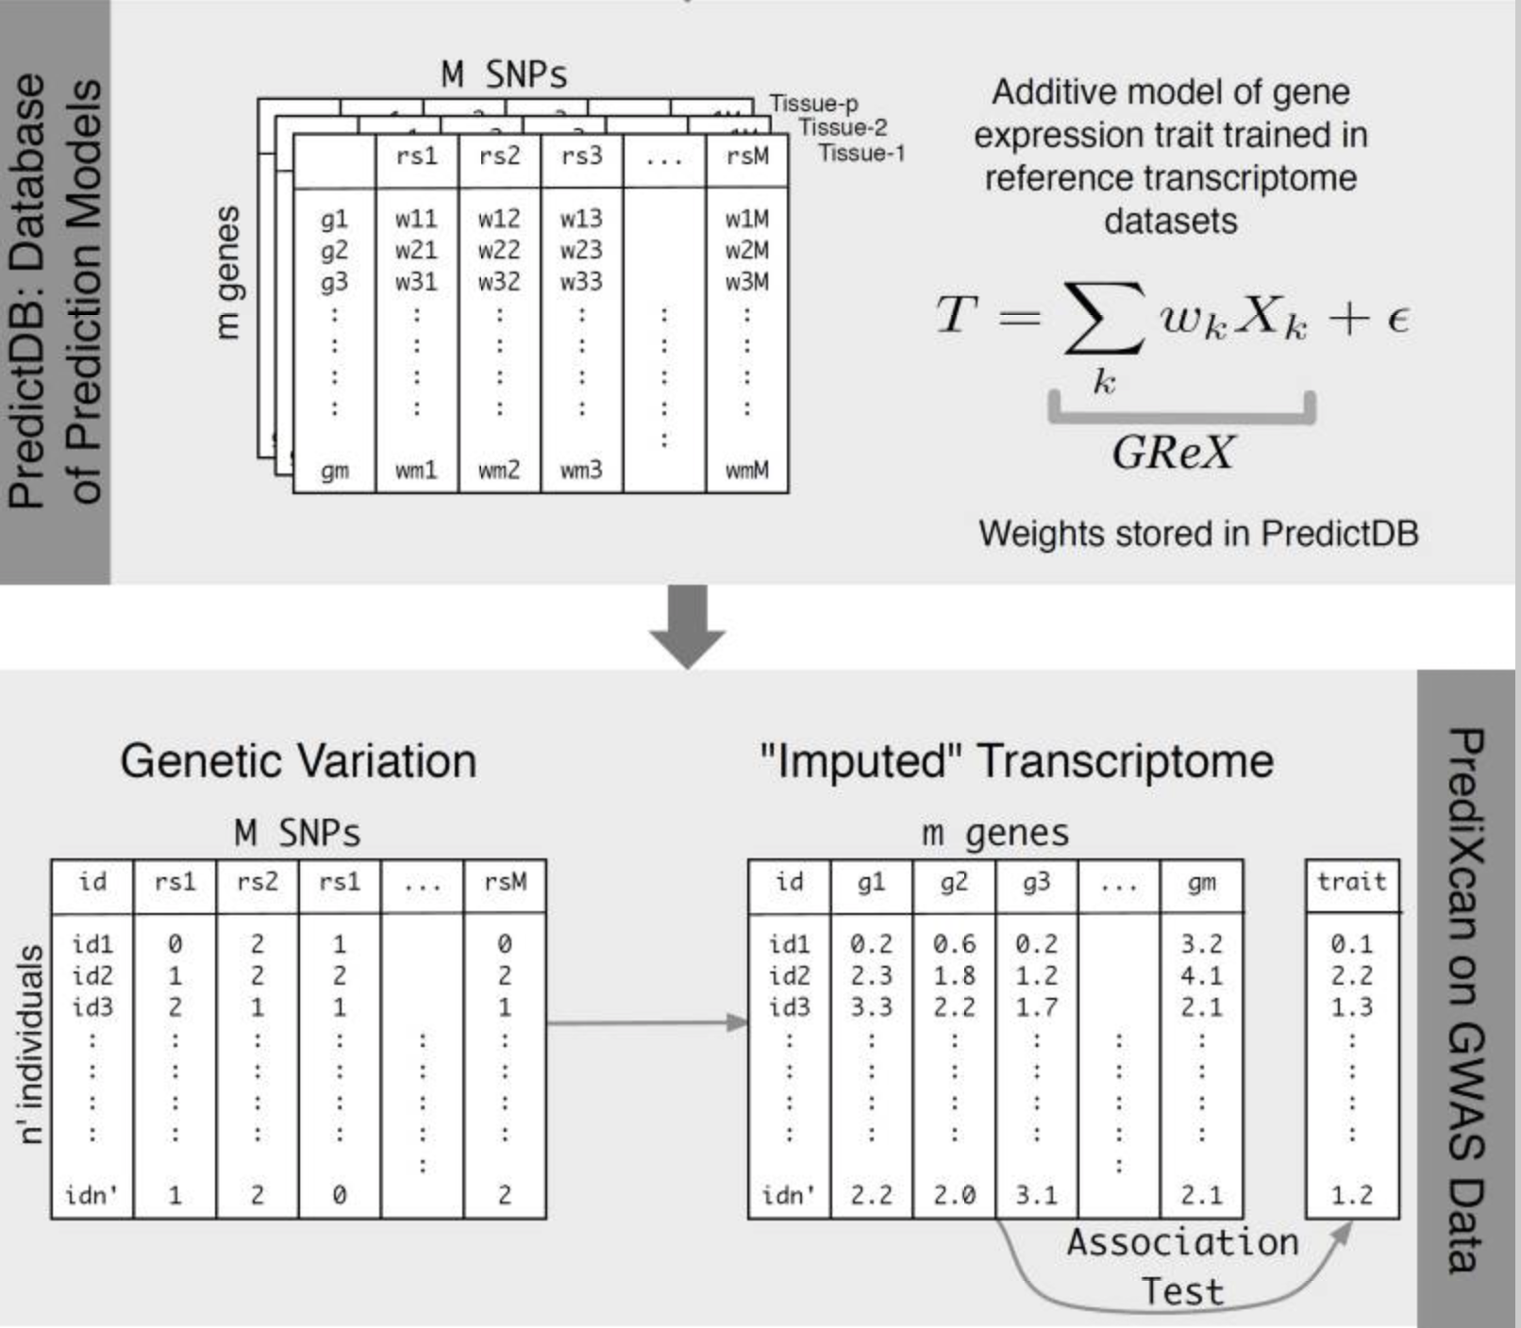
PrediXcan - TWAS
Top panel (same as bottom panel from previous slide):
Train a model for using genotype to predict expression of each gene in each tissue.
Bottom panel:
Apply the model to your GWAS data to calculate estimated transcription of each gene in tissues of interest.
Now test each gene’s transcription for association with trait.
Can use linear/logistic/Cox regression, non-parametric approaches, etc., as appropriate.

Slide 33
PrediXcan – note on model selection
In the model, a variety of SNP selection techniques are possible
Using the top SNP (strongest eQTL) only
Use the top few SNPs (e.g., eQTLs with p < 1E-2)
Use all the cis-eQTLs
Use penalized regression methods to select only some SNPs
LASSO forces all but a few of the weights to be 0
Elastic net shrinks some of the weights without forcing them to be 0
Include trans-eQTLs, too?
Elastic net and LASSO perform best; authors preferred elastic net.
Including trans-eQTLs didn’t seem to improve prediction much.

Slide 34
PrediXcan – note on model selection
How to decide what model is best?
The plot shows performance in the training data.
Out-of-sample testing was done, too.
Also looked at observed vs. predicted expression for specific genes.
Cross-validated prediction performance vs heritability This figure shows the prediction performance (R² of GReX vs. observed expression in red) compared to gene expression heritability estimates (black with 95% confidence interval in gray). Performance was assessed using 10-fold cross-validation in the DGN whole blood cohort (n=922) with the elastic net, polygenic score (p < 1×10⁻⁴), and using the top SNP for prediction.

Slide 35
Applying PrediXcan
PrediXcan was run using whole blood + elastic net models for several traits (T1D shown).
Reasonably good at finding associations with previously known T1D genes. At least some replication when applied to different GWAS data for the same trait
Also, perform gene set analyses for “top hit” genes

Slide 36
Running PrediXcan
PrediXcan is freely available as a pair of command-line Python programs (MetaXcan is also required).
Various models have been precomputed:
http://predictdb.org
Tutorial/manual:
https://github.com/hakyimlab/MetaXcan/wiki/Individual-level-PrediXcan:-introduction,-tutorials-and-manual

Slide 37
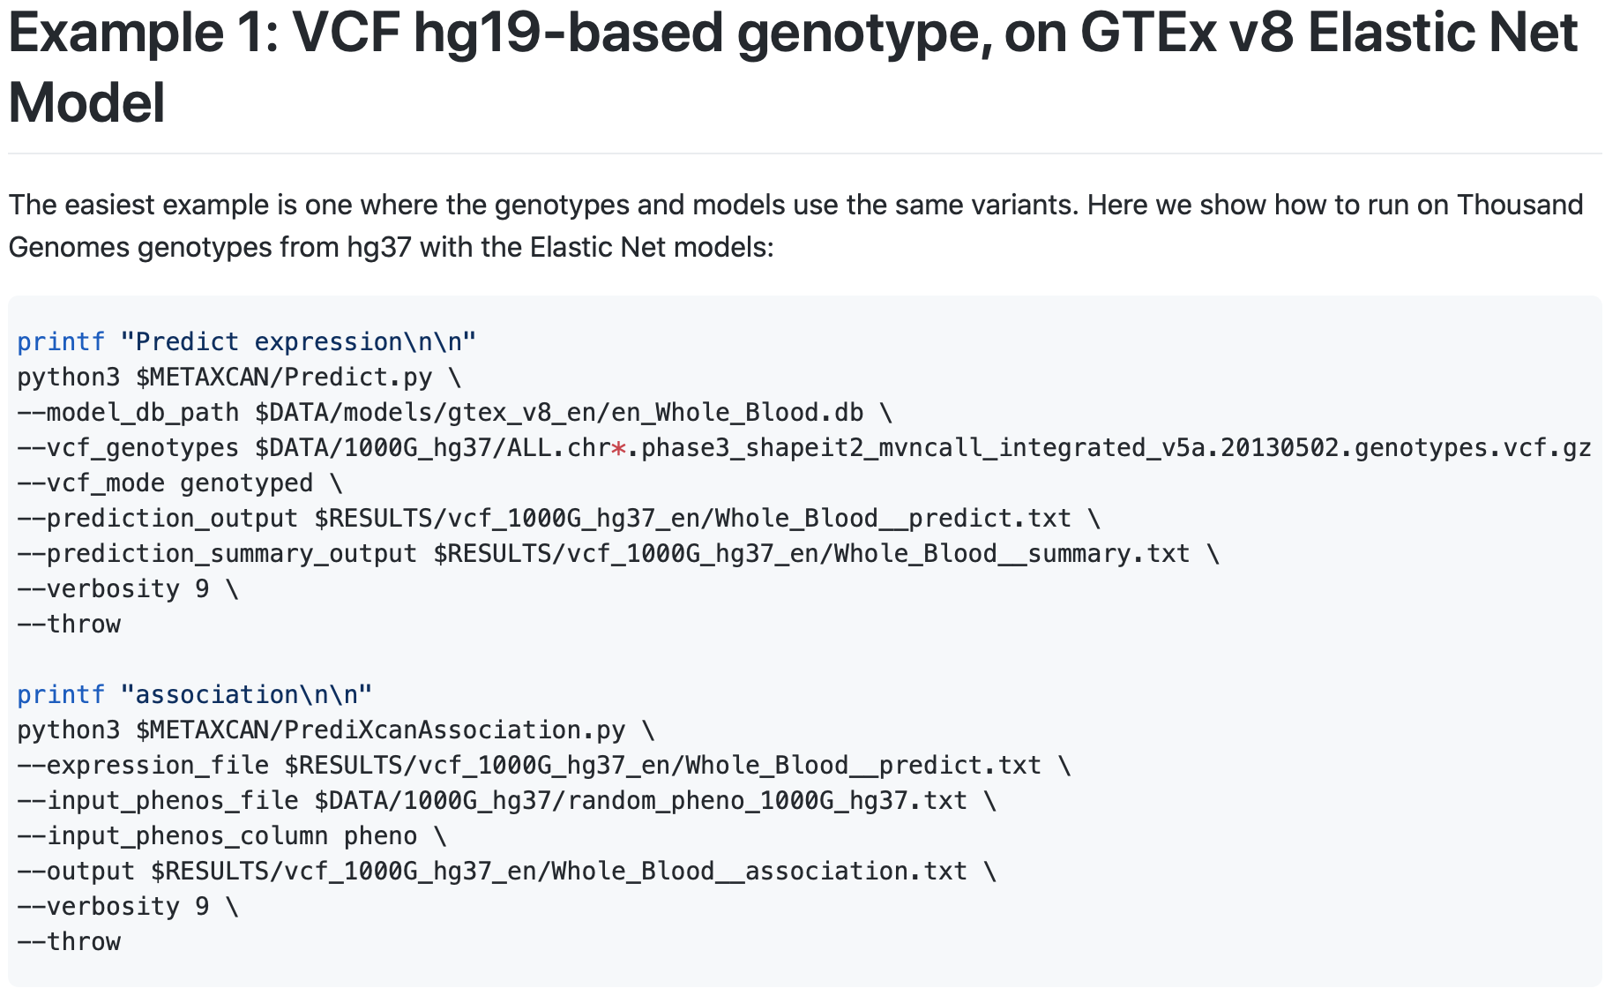
Running PrediXcan
Note: “mapping” your GWAS variants to the variant IDs in the pre-calculated model may take some work

Slide 38
TWAS with only GWAS summary statistics
Earlier we said:
Input data
GWAS dataset
Genotypes
Phenotypes
Transcriptome database
eQTL associations as a “training set” for predicting/imputing transcription in your GWAS data

Slide 39
TWAS with only GWAS summary statistics
What if you only have
GWAS dataset
Genotypes
Phenotypes
GWAS summary statistics
Transcriptome database
eQTL associations as a “training set” for predicting/imputing transcription in your GWAS data

Slide 40
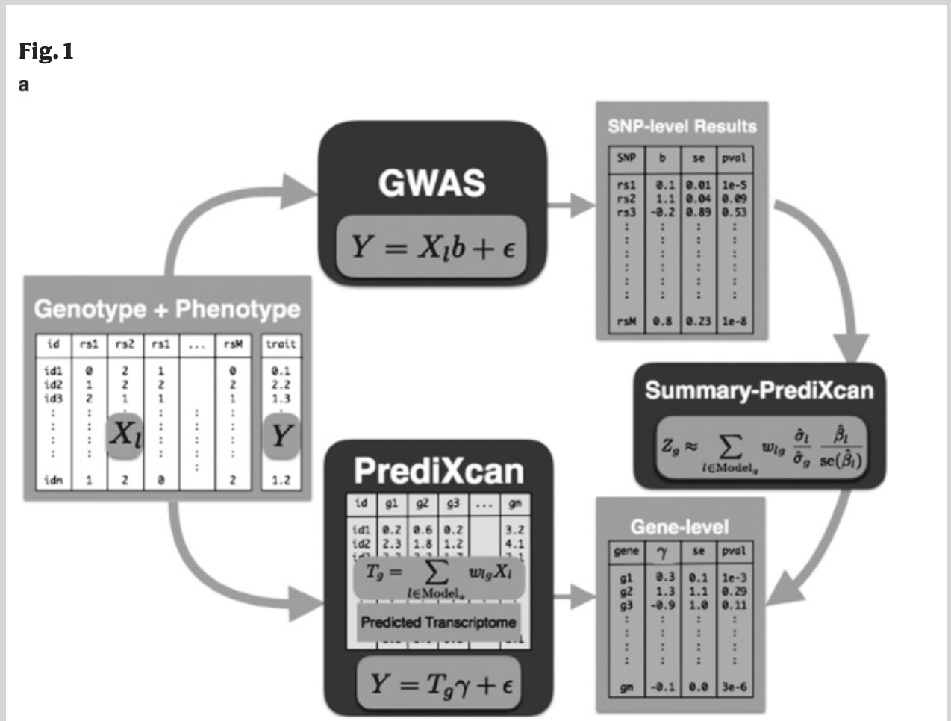
Summary statistic TWAS with S-PrediXcan
Barbeira, A. N., Dickinson, S. P., Bonazzola, R., Zheng, J., Wheeler, H. E., Torres, J. M., Torstenson, E. S., Shah, K. P., Garcia, T., Edwards, T. L., Stahl, E. A., Huckins, L. M., GTEx Consortium, Nicolae, D. L., Cox, N. J., & Im, H. K. (2018). Exploring the phenotypic consequences of tissue specific gene expression variation inferred from GWAS summary statistics. Nature communications, 9(1), 1825. https://doi.org/10.1038/s41467-018-03621-1
https://pubmed.ncbi.nlm.nih.gov/29739930/

Slide 41
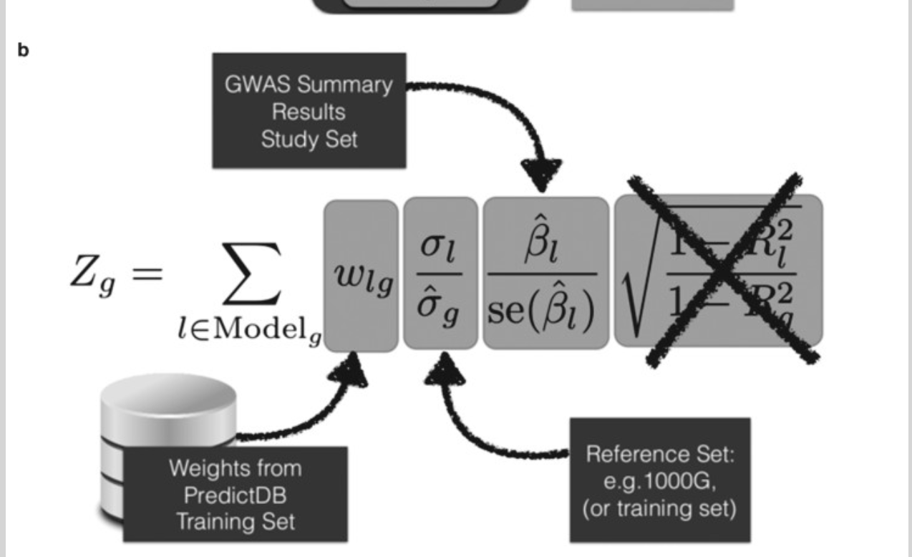
S-PrediXcan
b Shows the components of the formula to calculate PrediXcan gene-level association results using summary statistics. The different sets involved as input data are shown. The regression coefficient between the phenotype and the genotype is obtained from the study set. The training set is the reference transcriptome dataset where the prediction models of gene expression levels are trained. The reference set (1000G, or training set having some advantages) is used to compute the variances and covariances (LD structure) of the markers used in the predicted expression levels. Both the reference set and training set values are precomputed and provided to the user so that only the study set results need to be provided to the software. The crossed out term was set to 1 as an approximation. We found this approximation to have negligible impact on the results
“We find high concordance between PrediXcan and S-PrediXcan results indicating that in most cases, we can use the summary version without loss of power to detect associations.”

Slide 42
S-PrediXcan performance
Comparison of PrediXcan and S-PrediXcan results in real and simulated traits. This figure shows a comparison of PrediXcan vs. S-PrediXcan for a a simulated phenotype under null hypothesis of no genetic component; b a cellular phenotype (=intrinsic growth); and c bipolar disorder and type 1 diabetes studies from Wellcome Trust Case Control Consortium (WTCCC). Gene expression prediction models were based on the DGN cohort presented in ref. ¹¹. For the simulated phenotype, study sets (GWAS set) and reference sets (LD calculation set) consisted of African (661), East Asian (504), and European (503) individuals from the 1000 Genomes Project. When the same study set is used as reference set, we obtained a high correlation (coefficient of determination): r² > 0.99999. For the intrinsic growth phenotype, study sets were a subset of 140 individuals from each of the African, Asian, and European groups from 1000 Genomes Project. The reference set was the same as for the simulated phenotype. For the disease phenotypes, the study set consisted of British individuals, and the LD calculation set was the European population subset of the 1000 Genomes Project

Slide 43
MetaXcan: S-PrediXcan “pipeline”/framework
S-PrediXcan combines GWAS signals and eQTL signals based on linkage disequilbrium, and it outputs p-values relating gene expression to the GWAS trait.
If a gene is significant in S-PrediXcan, it could possibly be the result of “LD contamination” due to nearby but independent eQTL/GWAS signals.
In the suggested pipeline, S-PrediXcan results should be filtered to exclude associations based on “non-colocalized” signals.
The authors have made available data/tools for this.
http://gene2pheno.org
https://github.com/hakyimlab/phenomexcan

Slide 44
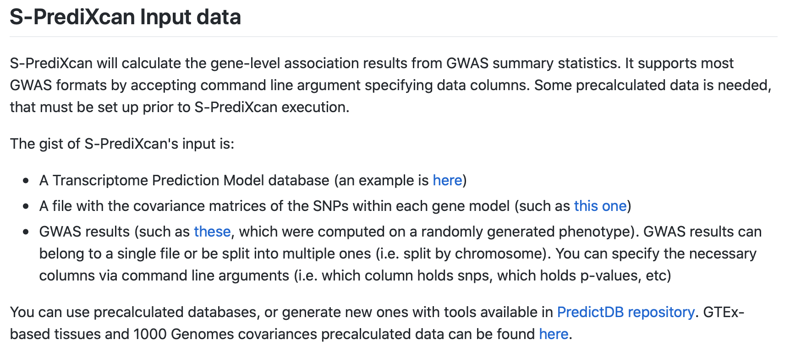
S-PrediXcan/MetaXcan implementation
S-PrediXcan/MetaXcan is implemented in Python https://github.com/hakyimlab/MetaXcan

Slide 45
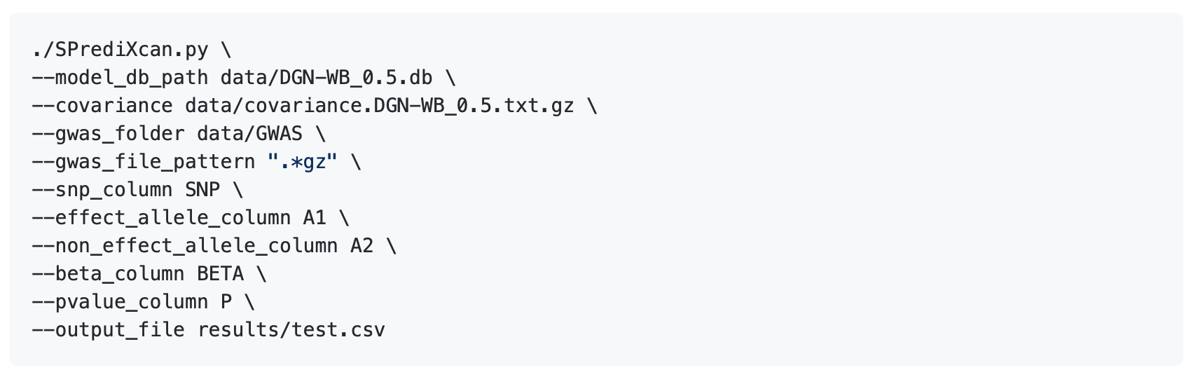
S-PrediXcan/MetaXcan implementation

Slide 46
Further extension: (S-)MultiXcan
“We develop a new method, MultiXcan, to test the mediating role of gene expression variation on complex traits, integrating information available across multiple tissue studies. We show this approach has higher power than traditional single-tissue methods. We extend this method to use only summary-statistics from public GWAS.”
“MultiXcan (MulTiXcan.py) and S-MultiXcan (SMulTiXcan.py) compute omic associations, integrating measurements across tissues while factoring correlation. For example, if you have prediction models, each trained on different regions of the brain, MulTiXcan will combine the information across all experiments. This is effectively a meta-analysis across tissues, where each tissue is an experiment and we explictly account for correlation.”
Barbeira, A. N., Pividori, M., Zheng, J., Wheeler, H. E., Nicolae, D. L., & Im, H. K. (2019). Integrating predicted transcriptome from multiple tissues improves association detection. PLoS genetics, 15(1), e1007889. https://doi.org/10.1371/journal.pgen.1007889
https://pubmed.ncbi.nlm.nih.gov/30668570/
https://github.com/hakyimlab/MetaXcan

Slide 47
Further evaluation of PrediXcan
“We tested the prediction accuracy of PrediXcan by comparing the predicted and observed gene expression levels, and also looked into some potential influential factors and a filter criterion with the aim of improving PrediXcan performance.”
Li, B., Verma, S. S., Veturi, Y. C., Verma, A., Bradford, Y., Haas, D. W., & Ritchie, M. D. (2018). Evaluation of PrediXcan for prioritizing GWAS associations and predicting gene expression. Pacific Symposium on Biocomputing. Pacific Symposium on Biocomputing, 23, 448–459.
https://www.ncbi.nlm.nih.gov/pmc/articles/PMC5749400/

Slide 48
Further evaluation of PrediXcan
“prediction accuracy was overall unsatisfactory as most genes had accuracy estimates near 0”
“For the two whole blood models, the directionality estimates centered on zero with a small standard deviation, which suggested that most predicted gene expression levels did not correlate with the observed gene expression levels ”
Authors suggest filtering to enrich for genes that have similar predictions for the same tissue based on models built from two or more databases
Performance of prediction directionality of PrediXcan models, DGN (top) and GTEx (bottom), on the YRI cohort. Directionality was computed between predicted and observed gene expression levels.

Slide 49
Further evaluation of PrediXcan
How useful is PrediXcan for prioritizing association results (from GWAS, e.g.)?
“When it came to prioritizing genetic association study results, PrediXcan was able to identify genes that were not significant in GWAS, and also retained significant variant-trait associations. These results were reassuring of the utility of PrediXcan. PrediXcan possessed promising features to reduce research burden by focusing on genes instead of SNPs, and map regulatory effects of distant SNPs onto responding genes, which are overlooked by most studies where only genes adjacent to SNPs are investigated[…] Overall, the present study found that PrediXcan performed differently when evaluated for different functions.”

Slide 50
How accurate is PrediXcan across populations?
7 PrediXcan weight databases
DGN whole-blood (further referred to as DGN)
GTEx v6 1KG whole blood
GTEx v6 1KG LCL
GTEx v6 HapMap whole blood
GTEx v6 HapMap LCL, GTEx v7
HapMap whole blood (GTEx WB)
GTEx v7 HapMap LCL (GTEx LCL)
Gene expression data: RNA-seq on lymphoblastoid cell line (LCL) samples for 464 individuals from five populations
Of these, 445 subjects were in the 1000 Genomes Phase 3 dataset
358 subjects of European descent
Utah residents with Northern and Western European ancestry (CEU, n = 89)
British individuals in England and Scotland (GBR, n = 86)
Finnish in Finland (FIN, n = 92)
Toscani in Italy (TSI, n = 91).
87 individuals of African descent from Yoruba in Ibadan, Nigeria (YRI, n = 87)
Mikhaylova, A. V., & Thornton, T. A. (2019). Accuracy of Gene Expression Prediction From Genotype Data With PrediXcan Varies Across and Within Continental Populations. Frontiers in genetics, 10, 261. https://doi.org/10.3389/fgene.2019.00261
https://pubmed.ncbi.nlm.nih.gov/31001318/

Slide 51
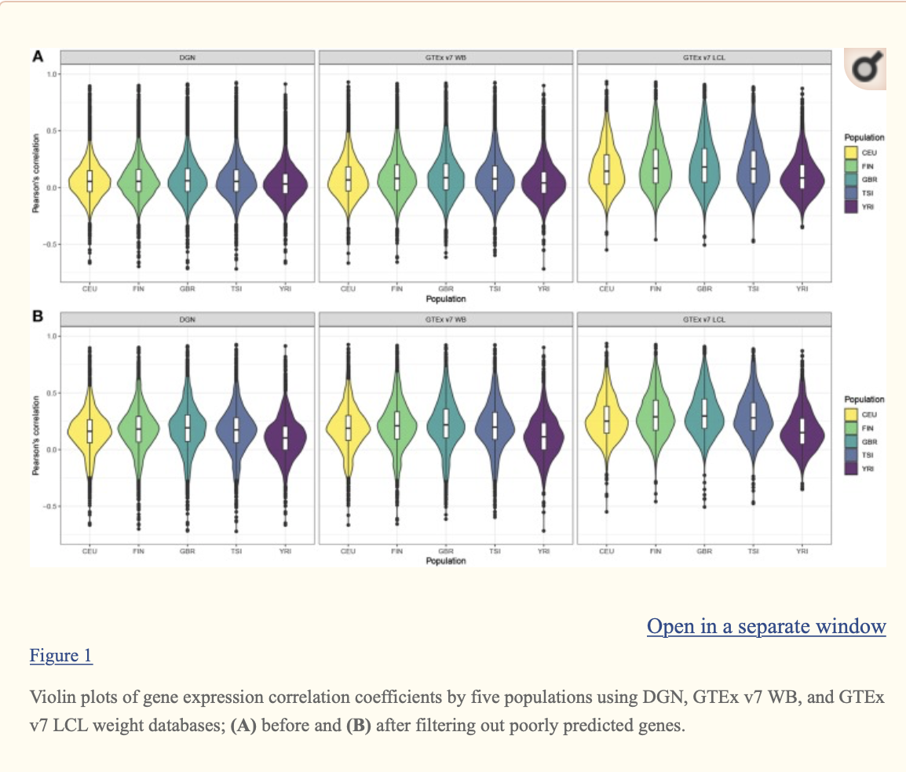
How accurate is PrediXcan across populations?
The majority of genes have very poor prediction accuracy—of the genes predicted with whole-blood databases, a third have negative correlations and a half have correlations between 0 and 0.2. Of the genes predicted with LCL, a fifth have negative correlations and over a third have correlations between 0 and 0.2. […]. The predictive accuracy is the lowest in the African sample. Across all populations, only a small number of genes were predicted with high accuracy (with r > 0.6). […]
Surprisingly, we also find highly significant differences in prediction accuracy with PrediXcan among the closely related European ancestry populations, with the Finnish, British, and Italian populations having significantly higher prediction accuracy than the CEU. These results are consistent across all seven PrediXcan weight databases we considered.

Slide 52
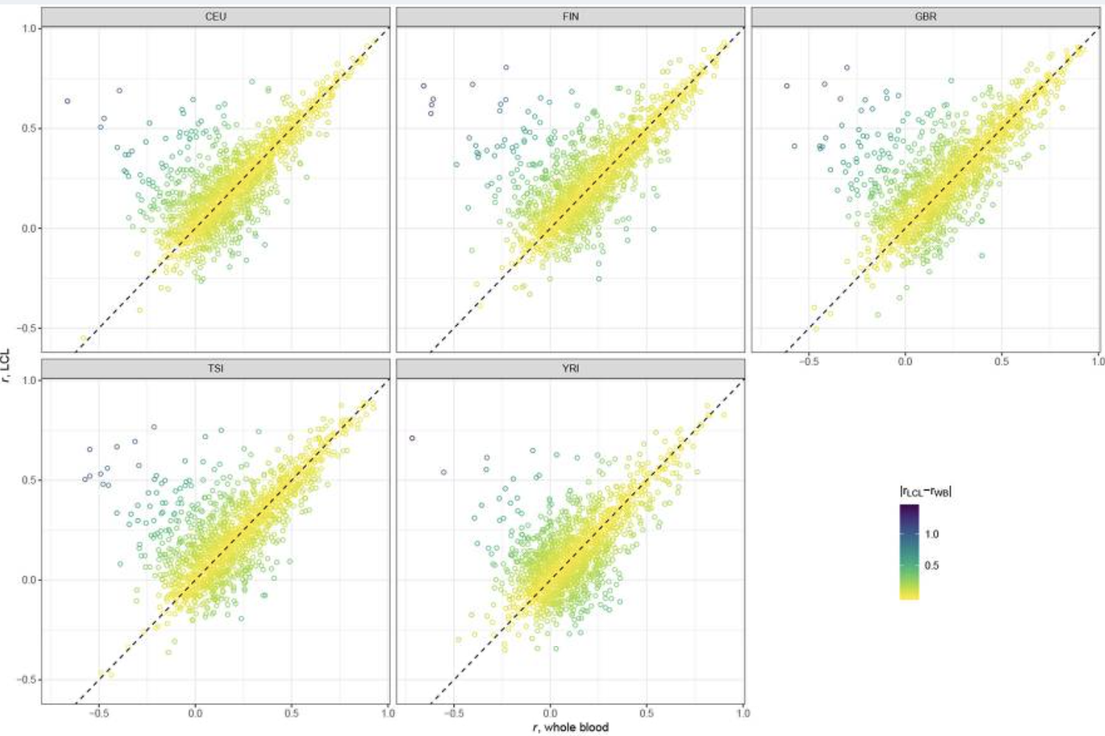
How accurate is PrediXcan across populations?
PrediXcan Prediction Accuracy Differs Between Tissues (lymphoblastoid > whole blood)

Slide 53
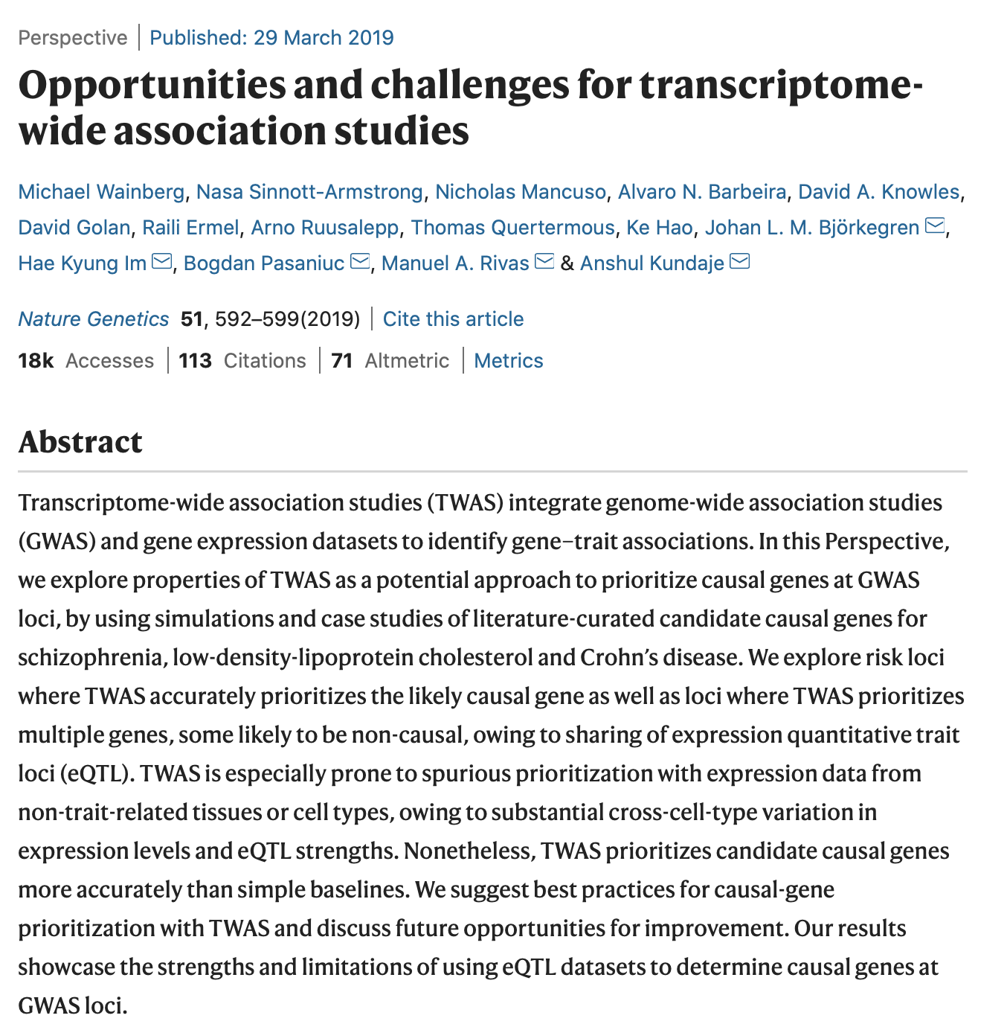
Further suggested reading
https://www.nature.com/articles/s41588-019-0385-z

Slide 54
Another common TWAS framework: FUSION
http://gusevlab.org/projects/fusion/
https://www.nature.com/articles/ng.3506

